Slide 1
Biotechnology -Recombinant DNA

Slide 2
What are we doing today?
Hormones and vaccines are developed using recombinant DNA and associated biotechnological techniques (SHE)

Slide 3
DNA Technology
Genetic engineering is the use of technology to alter the genomes of organisms.
It allows the insertion of a foreign gene into new cells, which are then able to produce a different product.
Biotechnology includes genetic engineering and other techniques to make use of natural biological systems to achieve an end desired by humans.

Slide 4
The Cloning of a Gene
When many copies of the same gene are obtained, the gene is said to be cloned - is accomplished by:
Recombinant DNA (rDNA) Technology.
DNA from at least two different DNA sources.
Vector used to introduce foreign DNA into a host cell.
Plasmids (from bacteria), viral DNA, retroviruses.
Enzymes to “cut and seal”.
Restriction enzymes cleave DNA (“molecular scissors”) to produce “sticky ends”.
DNA ligase seals DNA into an opening created by the restriction enzyme (“molecular glue”).

Slide 5
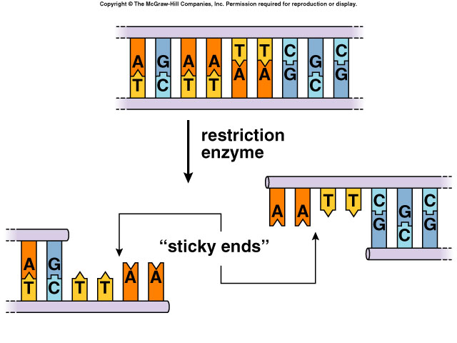

Slide 6
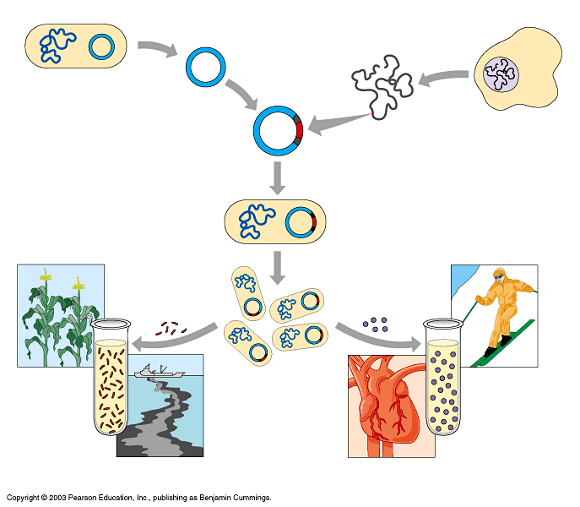
Bacterium
1
Plasmid isolated
Cell containing gene of interest
2
DNA
isolated
3
Gene inserted into plasmid
Bacterial chromosome
Plasmid
Gene of interest
Recombinant DNA (plasmid)
DNA
4
Plasmid put into bacterial cell
Recombinant bacterium
5
Cell multiplies with gene of interest
Copies of gene
Copies of protein
Gene for pest resistance inserted into plants
Clones of cell
Protein used to make snow form at higher temperature
Gene used to alter bacteria for cleaning up toxic waste
Protein used to dissolve blood clots in heart attack therapy
Figure 12.3

Slide 7
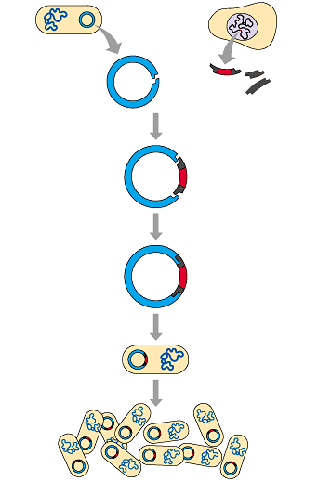
Genes can be cloned in recombinant plasmids
E. coli
1
Isolate DNA from two sources
Human cell
2
Cut both DNAs with the same restriction
enzyme
Plasmid
DNA
Gene V
Sticky ends
Bacteria take the recombinant plasmids and reproduce
This clones the plasmids and the genes they carry
Products of the gene can then be harvested
3
Mix the DNAs; they join by base-pairing
4
Add DNA ligase to bond the DNA covalently
Recombinant DNA plasmid
Gene V
5
Put plasmid into bacterium by transformation
6
Clone the bacterium
Bacterial clone carrying many copies of the human gene

Slide 8
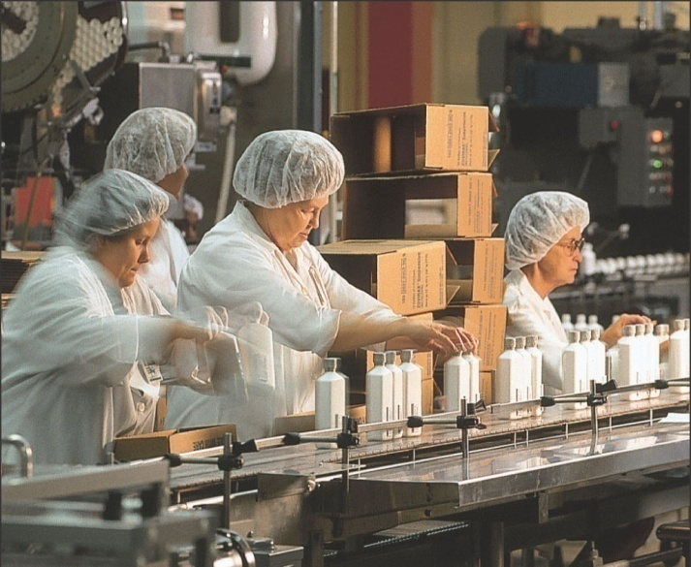
Biotechnology Products
Transgenic organisms have a foreign gene inserted into them.
Transgenic Bacteria
Insulin.
Human Growth Hormone.
Hepatitis B vaccine.
Promote plant health.
Degrade wastes.
Produce chemicals.
Help mine metals.

Slide 9
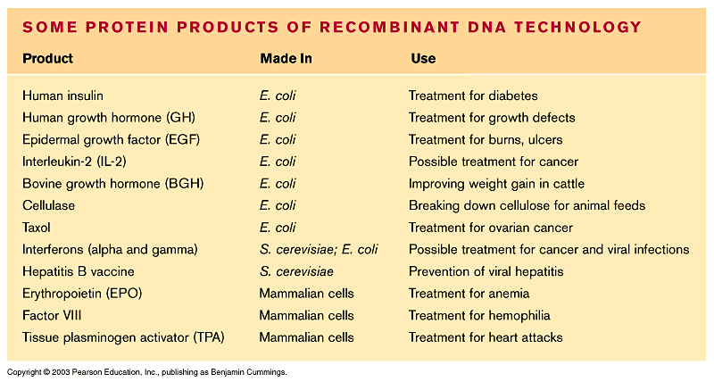
Recombinant cells and organisms can mass-produce gene products
Recombinant cells and organisms are used to manufacture useful proteins

Slide 10
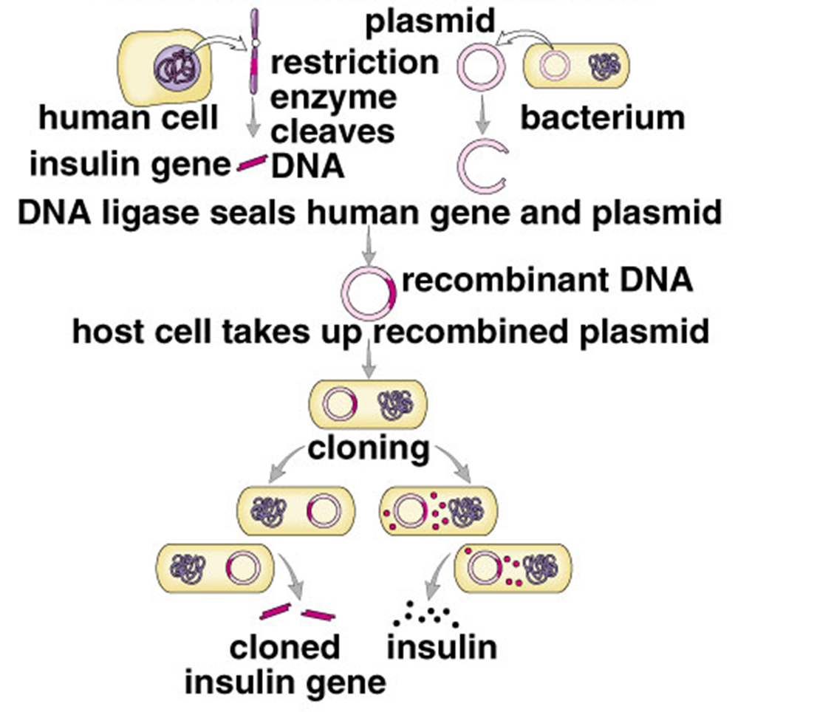
Hormones - Insulin
Used to collected from pancreas of pigs and cattle.
In 1982, produced and approved for treatment by recombinant DNA.
Human gene for producing insulin introduced to bacterial cells that produce insulin.
Cultured in vats to produce large quantities of insulin to use as treatment for diabetes.

Slide 11
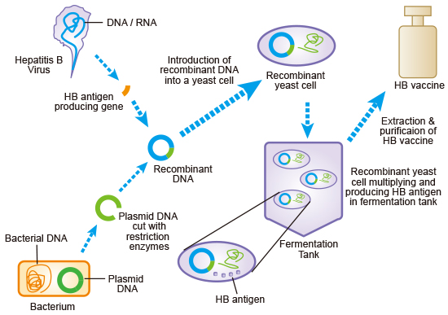
Vaccines - Hepatitis B
First vaccine produced by using recombinant DNA in 1986.

Slide 12
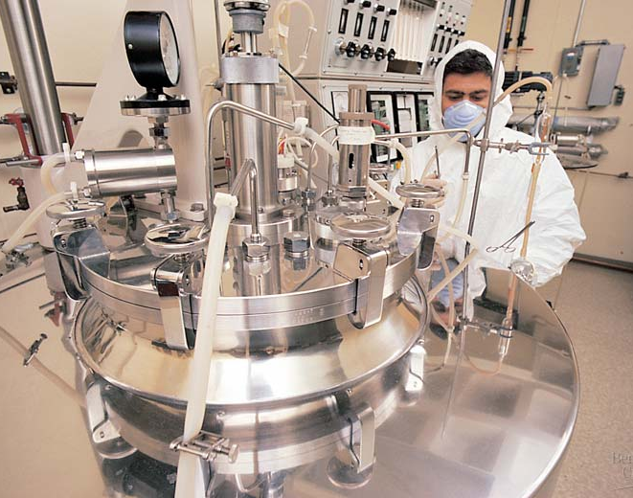
DNA technology is changing the pharmaceutical industry and medicine
Hormones, cancer-fighting drugs, and new vaccines are being produced using DNA technology
This lab equipment is used to produce a vaccine against hepatitis B

Slide 13
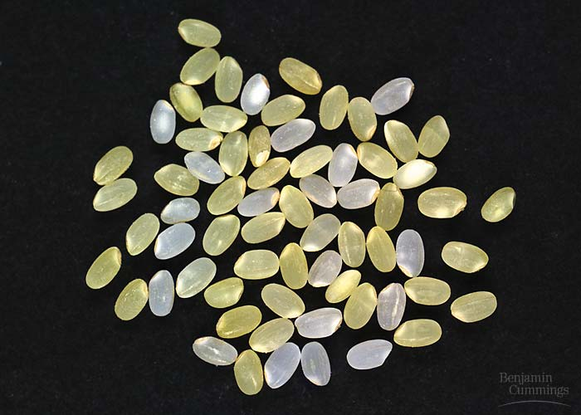
Genetically modified organisms are transforming agriculture
New genetic varieties of animals and plants are being produced
A plant with a new trait can be created using the Ti plasmid
Golden rice” has been genetically modified to contain beta-carotene
This rice could help prevent vitamin A deficiency

Slide 14
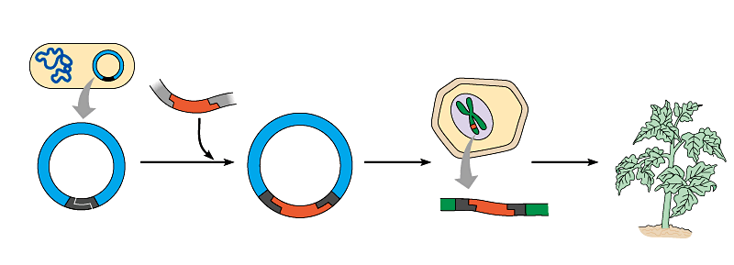
How are these new plants created?
Agrobacterium tumefaciens
DNA containing gene for desired trait
Plant cell
1
2
3
Ti plasmid
Recombinant Ti plasmid
Insertion of gene into plasmid using restriction enzyme and DNA ligase
Introduction into plant cells in culture
Regeneration of plant
T DNA
T DNA carrying new gene within plant chromosome
Plant with new trait
Restriction site

Slide 15
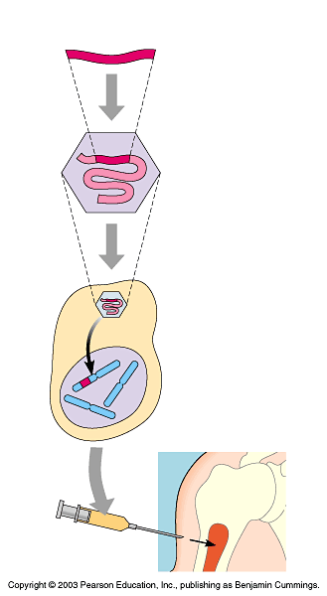
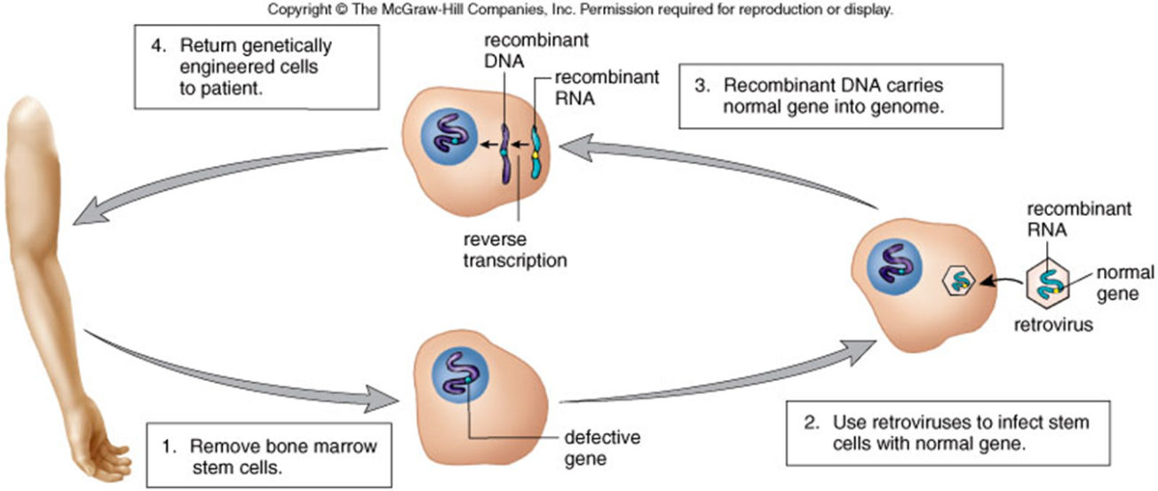
Gene therapy may someday help treat a variety of diseases
Cloned gene (normal allele)
Techniques for manipulating DNA have potential for treating disease by altering an afflicted individual’s genes
Progress is slow, however
There are also ethical questions related to gene therapy
1
Insert normal gene into virus
Viral nucleic acid
Retrovirus
2
Infect bone marrow cell with virus
3
Viral DNA inserts into chromosome
Bone marrow cell from patient
Bone
marrow
4
Inject cells into patient

Slide 16
Research
How recombinant DNA is helping to produce new vaccines?
What difficulties are involved with this process?
Examples of vaccines produced with the help of recombinant DNA
Human growth hormone is also produced using recombinant DNA. How long has this been happening?
What are the uses and benefits of human growth hormone?
Are there any risks/ethical concerns regarding the use and manufacture of human growth hormone.

